Slide 1
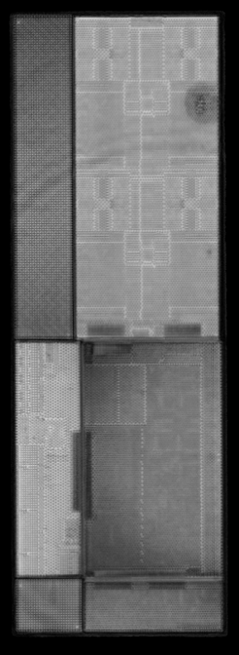
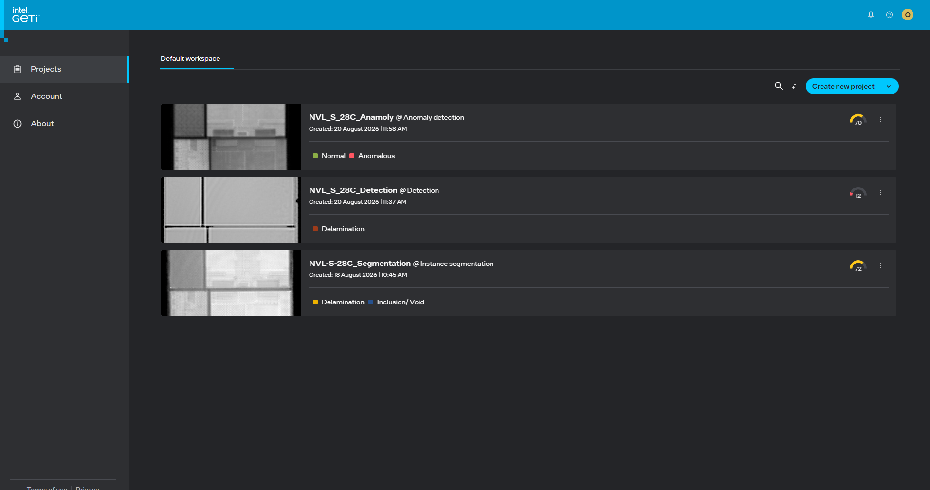
Geti CSAM NVL Test Runs
Defect detection experiment: setup, run plan, and model selection criteria
Benchmark
20
Bad
14
Good
6
Segm.
mAP 22.82%
Web
24→78
DOE objective
Compare 3 model families on the same NVL CSAM dataset.
Answer which task is best for screening, localization, and engineering review.
Quantify trade-offs in accuracy, speed, complexity, and deployment fit.
Run setup
Dataset: 20 NVL images = 14 defect-positive + 6 good units.
Labels: Delamination and Inclusion/Void under the current Web Geti taxonomy.
Design: one frozen split reused across all tasks; equal data and evaluation basis.
Device: same training environment and same run constraints for each candidate.
What we are testing
Detection = fast defect presence + bounding-box localization.
Anomaly = abnormality screening when defect taxonomy is incomplete.
Segmentation = pixel-level masks for geometry and engineering detail.
Benchmark: 20 NVL images, same frozen evaluation basis across all 3 model families

Slide 2
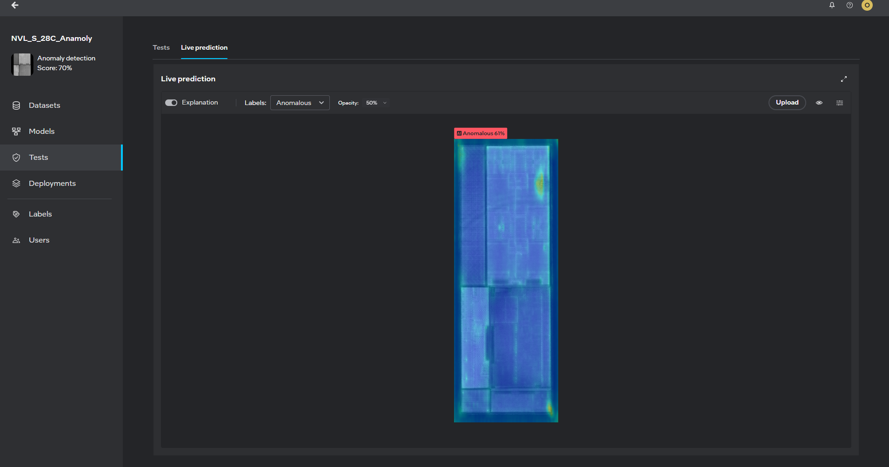
Anomaly Model
Normal-vs-abnormal screening for deviations
Anomaly Model
Anomaly detection learns the normal pattern and flags anything that deviates from it. It is useful when the defect taxonomy is incomplete or when unknown patterns may appear.
Operational meaning: why this task exists and when it matters.
Objective: catch abnormal scan behavior before the defect is explicitly labeled.
Parameters: trained against good-unit baselines; sensitive to brightness, texture, and process drift.
Results: useful for screening and prioritization; higher false alarm risk than explicit defect models.
Improvement: increase good-unit diversity; calibrate thresholds; combine with a downstream detection or segmentation pass.

Slide 3
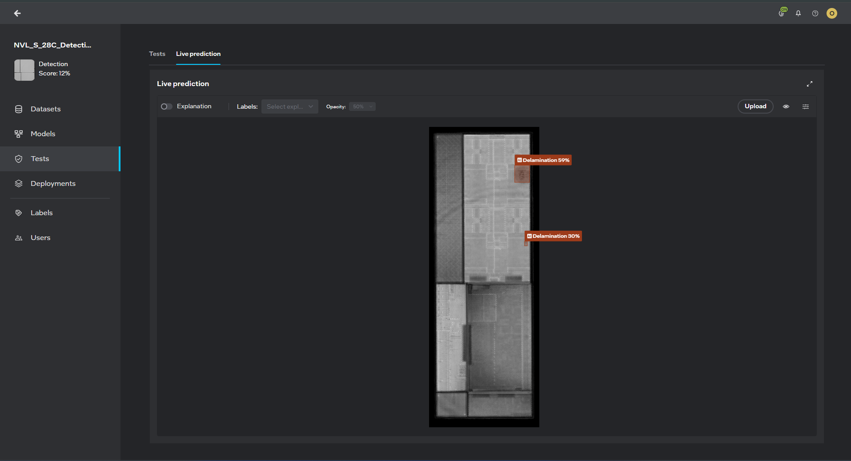
Detection Model
Bounding-box localization for rapid defect screening
Detection Model
Detection defines a defect as a localized object: a bounding box identifies the region of interest without tracing the exact boundary.
Objective: identify whether a defect is present and roughly where it is located.
Parameters: box-level localization, lighter annotation burden, faster training and inference.
Results: strong for first-pass review and obvious defects; weaker on irregular boundaries and exact sizing.
Improvement: add low-contrast and edge-case images; tune confidence thresholds; use as a front-end filter to segmentation.

Slide 4
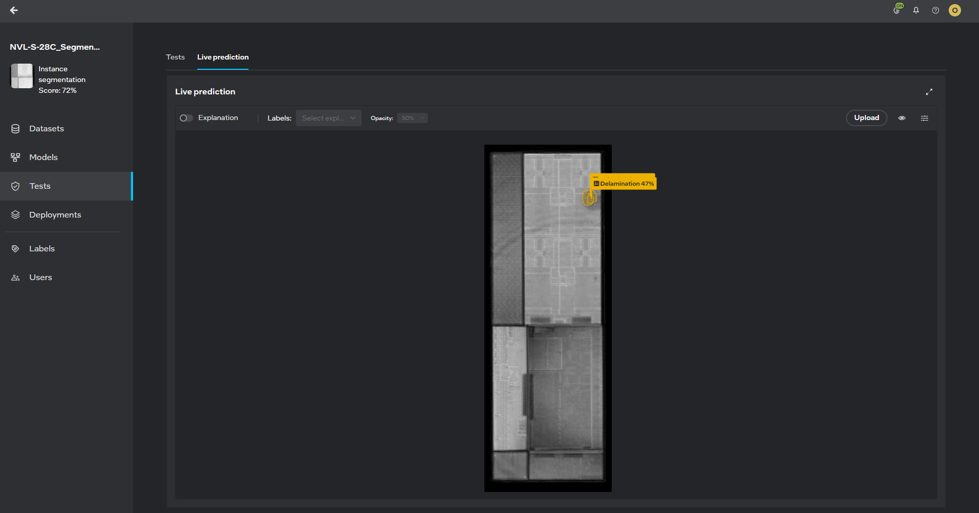
Instance Segmentation Model
Pixel-level mask generation for defect geometry
Instance Segmentation Model
Instance segmentation assigns a mask to each individual defect. This captures the exact shape, size, and boundary, which is critical when defect geometry drives severity and root-cause interpretation.
Objective: localize every defect instance at pixel level and preserve defect morphology.
Parameters: mask-based training, higher annotation effort, greater computational cost, better localization precision.
Results: best technical precision; NVL baseline mAP 22.82%, mAP@0.5 46.53%, mAP@0.75 14.85%, best validation checkpoint mAP 28.59%, mAP@0.5 79.21%.
Improvement: improve annotation consistency on subtle boundaries; add challenging multi-instance and low-contrast examples; refine threshold tuning.

Slide 5
Model Comparison Summary
Pros, cons, accuracy, and technical limitations
Anomaly Model
Pros:
Strong for outlier detection and unknown defect discovery.
Useful when defect taxonomy is incomplete or changing.
Good as alerting layer and review-prioritization tool.
Cons:
Higher false alarm rate and weaker object-level localization.
Accuracy/limitations:
Excellent for abnormality screening, weaker for class definition and boundary accuracy.
Run view:
Best for flags and prioritization, not for final defect certification.
Detection Model
Pros:
Fastest, simplest, easiest to explain and deploy.
Best for operational triage and rapid screening.
Lower annotation effort and faster iteration cycles.
Cons:
Coarse localization and weak defect-shape precision.
Accuracy/limitations:
Useful for rough defect presence detection, not precise sizing or mask fidelity.
Run view:
Good front-end screening model, but not the final technical judge.
Instance Segmentation Model
Pros:
Highest technical precision and best defect geometry understanding.
Captures exact shape, area, and boundary quality.
Strongest for engineering review and defect-root-cause analysis.
Cons:
Highest annotation burden and computational complexity.
Accuracy/limitations:
Strongest technical model, but still limited by small benchmark size and annotation quality.
Run view:
NVL baseline mAP 22.82%, mAP@0.5 46.53%, mAP@0.75 14.85%; best validation checkpoint mAP 28.59%, mAP@0.5 79.21%.

Slide 6
Next Steps:
Finetuning the accuracy of the models for NVL (Omkar)
Work on Deployment of the Model for WIPs (Omkar)
Training for the team for Geti (Omkar)
Pull in team for support for other products.

